Slide 1
Module 5.7.1: Importing Libraries

Slide 2
Files
We learned how to deal with files.
Now we will learn how to deal with a specific type of file:
A Python file!
Python files are text files, filled with Python code.

Slide 3
import
We want the ability to use (execute) the code in a different Python script.
We will do this by using the import statement.

Slide 4
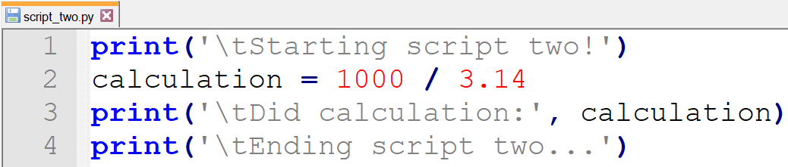
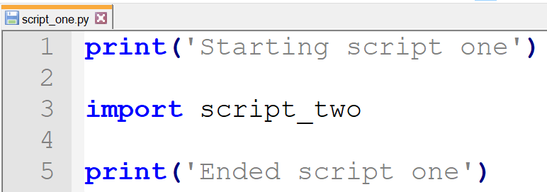
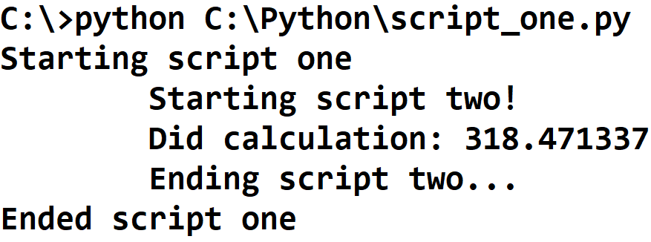

Slide 5
Using import
When using import, the whole file is executed, line-by-line.
This means that the current script is paused until all lines of the other script have finished executing. Only then, the current script continues to run.
You can only import scripts that are in the same directory (folder) as your script.

Slide 6
Using Imported Functions
After importing, we can now use functions defined in our imported script!
We do this just the same as we use methods – by using a dot.

Slide 7
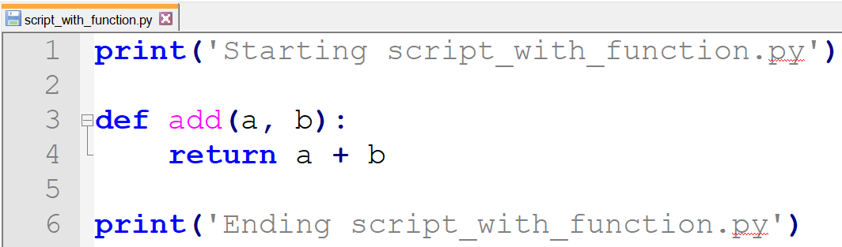
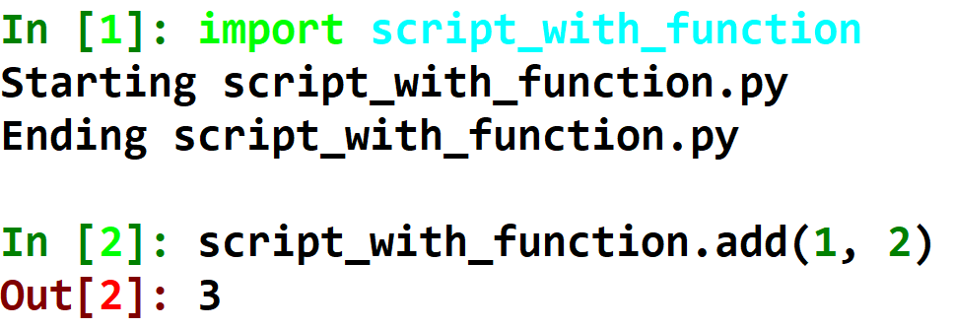

Slide 8
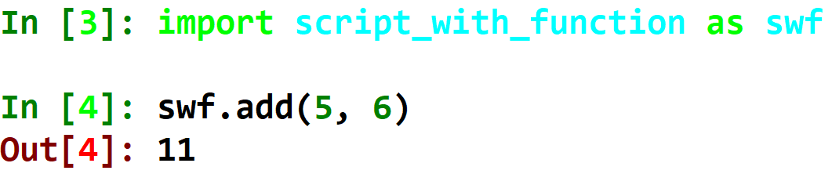
Changing The Imported Script’s Name
We can use the as keyword to give the imported script a nickname.

Slide 9
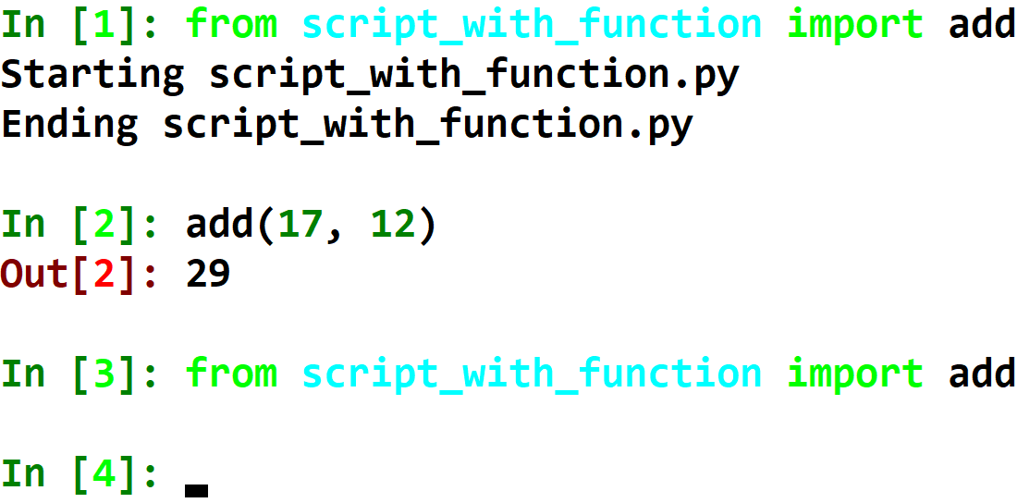
Importing a Single Function
We can use the from keyword to import a specific object from our script.
Once imported, you cannot import a script again. You will need to restart ipython to re-import a module.

Slide 10
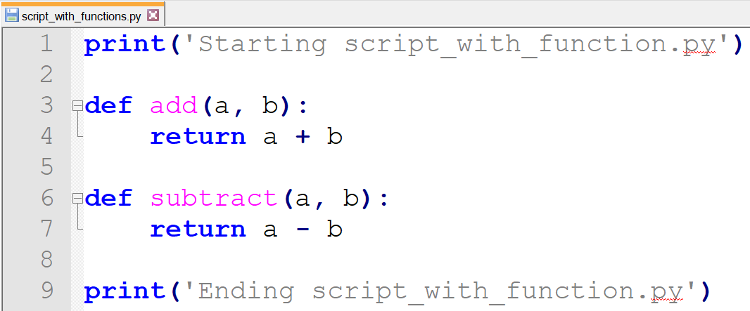
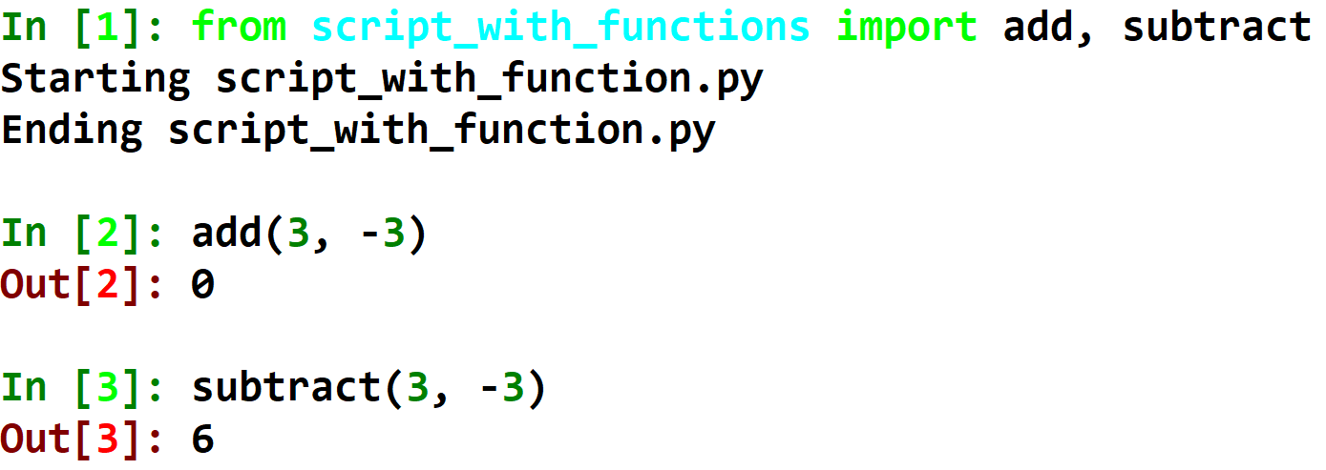
Importing Multiple Functions
Separate imported names with commas to import multiple items from your script.

Slide 11
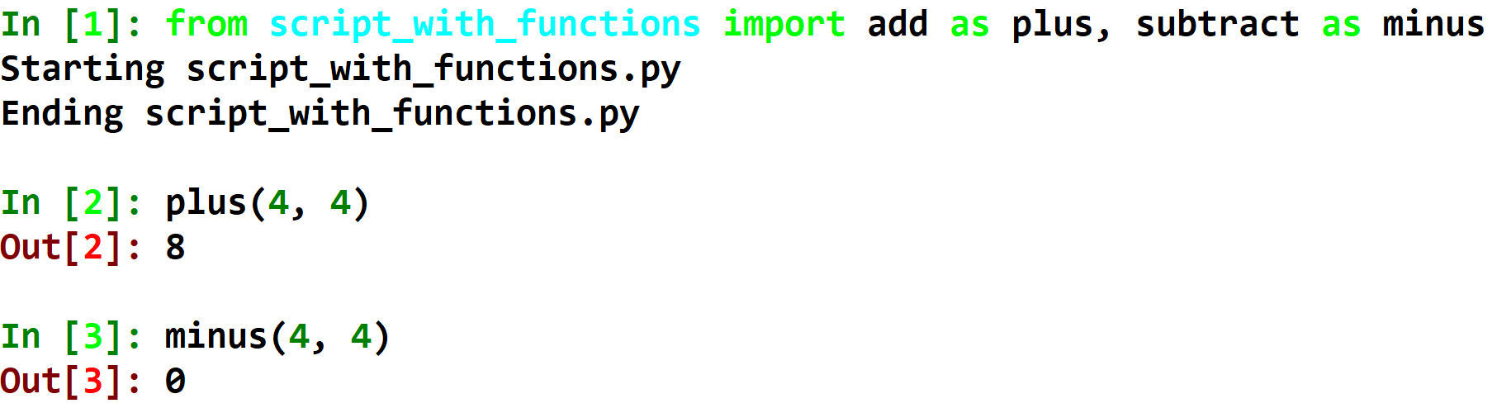
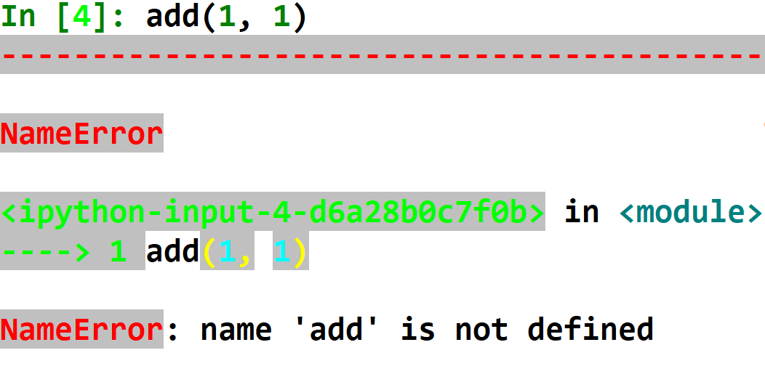
Using as with from

Slide 12
from module_name import *
Using * instead of specific function names imports all the functions in the other script.
This sounds useful, but it is very bad to do.
Let me explain!

Slide 13
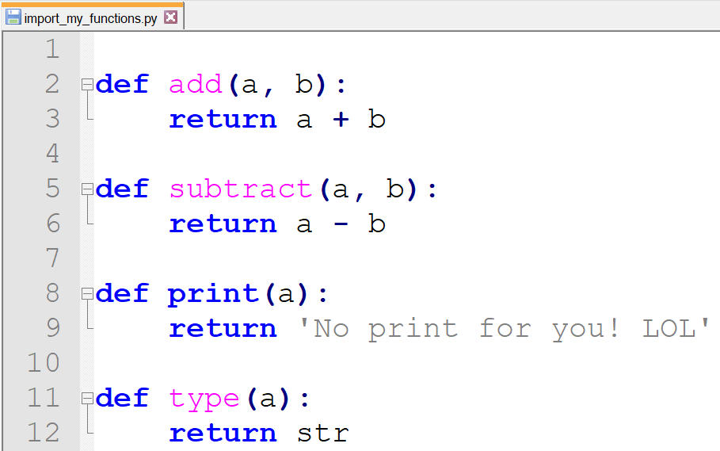
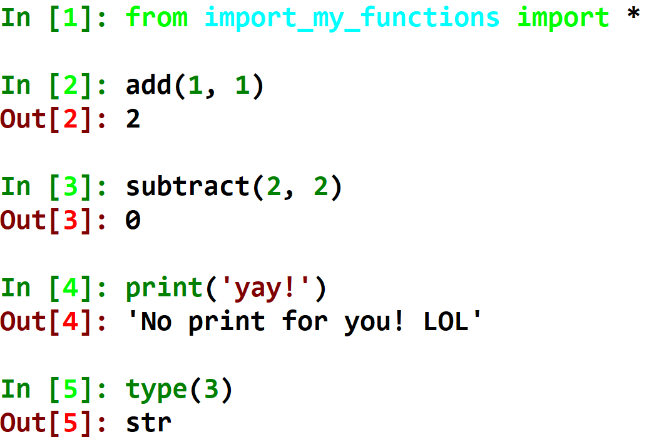
This is my script. I want to easily import add and subtract, so I use *.
The functions will override my own function! And I can’t do anything about it!

Slide 14
So…
So never use “from module import *”!

Slide 15
What is __name__
Modules

Slide 16
__name__
The variable __name__ is a built-in variable, that holds the name of the running script.
If the script is running because the user decided to run it – __name__ will be “__main__”, because it is the primary script the user decided to run.
If the script is running because it is being imported from a different script, __name__ will be the script name.

Slide 17
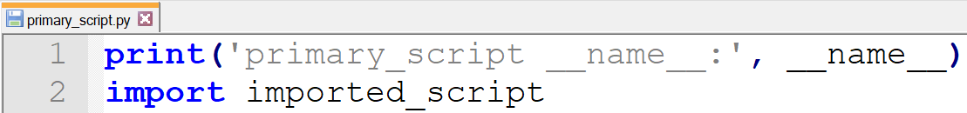
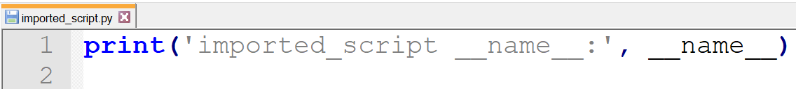
Let’s print __name__ out.
Once from a script that we will run directly.
Once from a script that will be run from a different script’s import.

Slide 18
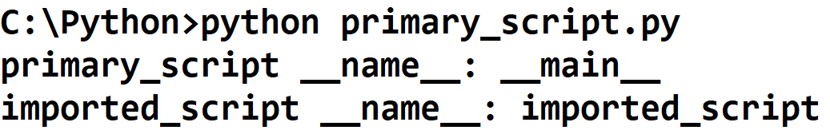

Slide 19
Why We Care
Let’s say I wrote a script.
I wrote a function that is useful for my script, but it also can be useful for other scripts.
I use my function in my main function.
I want to give other scripts the ability to import my function and use it on their own, without running my main function (which will print and run things that are only important to the current function).
For this reason, only if __name__ is “__main__” (which means that only if the user specifically chose to run this script) will my main function activate.

Slide 20
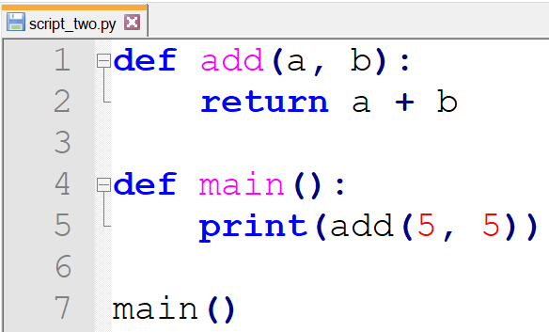
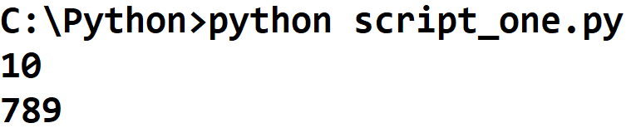
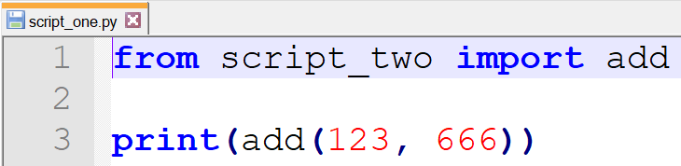
When you don’t use if __name__...
Even though I only wanted to print the sum 789, the sum 10 was printed because main() was called in the other script.

Slide 21
External Libraries
Modules

Slide 22
External Libraries
There are many modules that are built in to Python. They are VERY useful. These make up what is called the “Standard Library”.
We can access them by using the import statement. We will learn how to use them in one of the coming lessons!

Slide 23
Laziness
Many programmers don’t learn these modules because they are too lazy to read about them. This is a big mistake.
10 minutes of reading about a module can save you hours and hours of programming!
You would never believe what absurd code programmers come up with, just because they didn’t know a simple, efficient function existed in one of the builtin modules of the Standard Library.

